Slide 2
IBM Cloud & Cognitive — Create a Microservice using IBM Cloud Functions
Abdulrahman Aloraini Developer Advocate
Hussah Alakeel Developer Advocate

Slide 3
Please Register on IBM Cloud through the link below — https://ibm.biz/BdqtEB
Notes:
The link is case sensitive

Slide 4
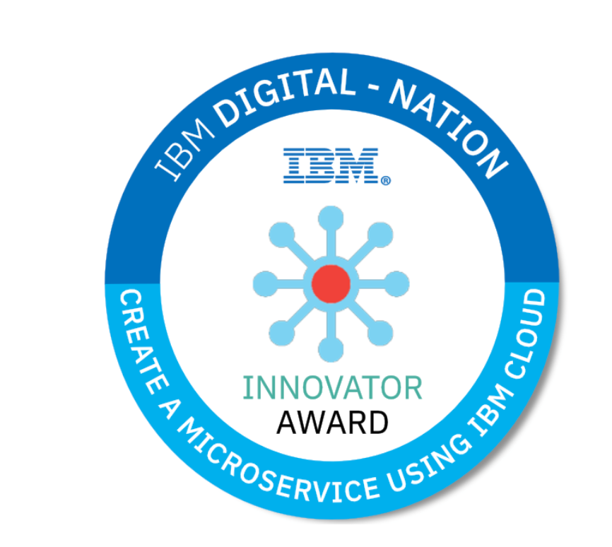

Slide 5

Agenda
The concept of Microservices
Benefit of Microservices
Microservices Architecture vs. Monolithic
What does Serverless mean?
Hands-on Lab

Slide 6
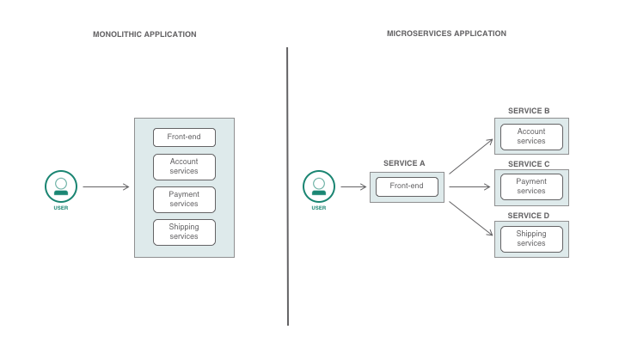
The concept of Microservices
A microservices architecture splits your application into multiple services that perform fine-grained functions and are part of your application as a whole. Each of your microservices will have a different logical function for your application.

Slide 7
Benefit of Microservices
Flexibility in Using Technologies and Scalability.
Easier to Build and Maintain Apps.
Organized Around Business Capabilities.
Improved Productivity and Speed.
Autonomous and Cross-functional Teams.

Slide 8
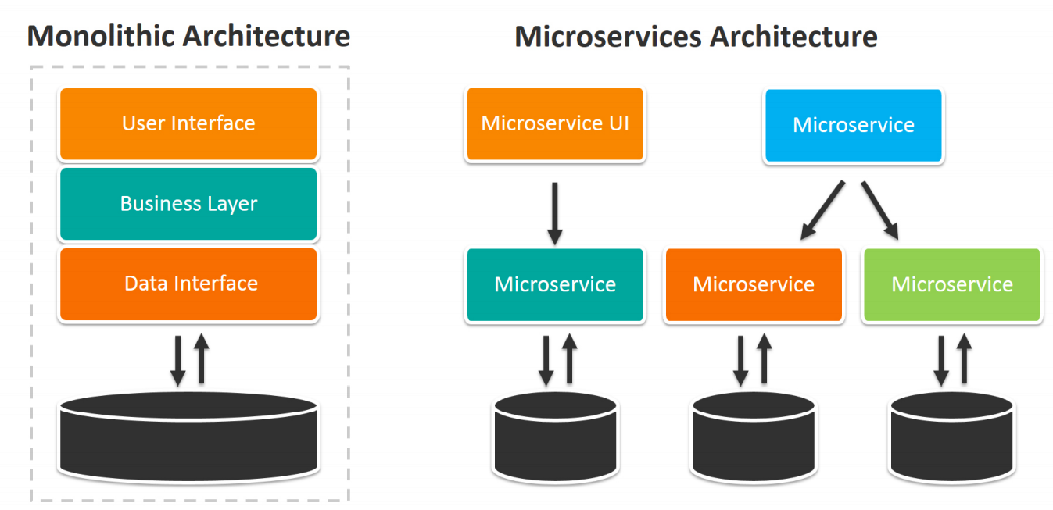
Microservices Architecture vs. Monolithic
Notes:
Has to be modified

Slide 9
What is Serverless
Serverless is an approach to computing that offloads responsibility for common infrastructure management tasks to cloud providers and tools, allowing engineers to focus their time and effort on the business logic specific to their applications or process.
The most useful way to define and understand serverless is focusing on the handful of core attributes that distinguish serverless computing from other compute models, namely:
The serverless model requires no management and operation of infrastructure, enabling developers to focus more narrowly on code/custom business logic.
Serverless computing runs code only on-demand on a per-request basis, scaling transparently with the number of requests being served.
Serverless computing enables end users to pay only for resources being used, never paying for idle capacity.
Serverless is fundamentally about spending more time on code, less on infrastructure.

Slide 10

Hands-on
Sign-up or Log-in to your IBM Cloud Account:
https://ibm.biz/BdqtEB

Slide 11
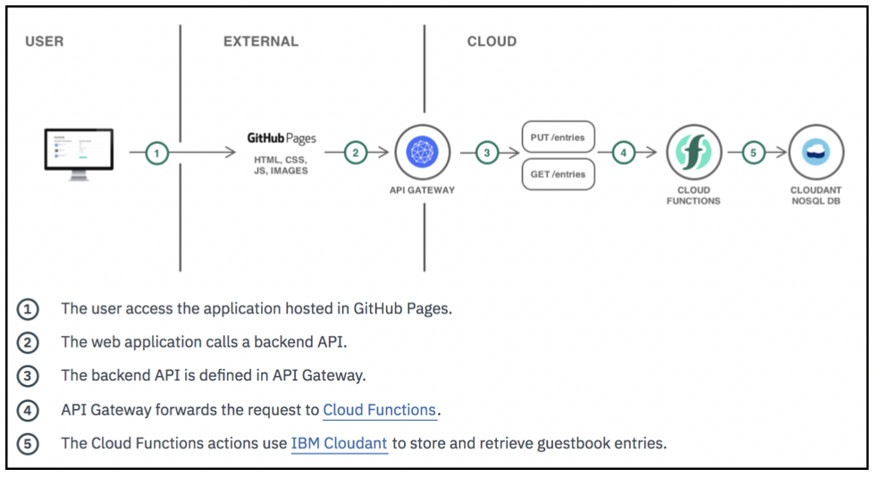
What are we going to do exactly in the lab?

Slide 12

About IBM Cloudant
A database that runs as a service on IBM Cloud.
It stores and retrieves data. More specifically, it is a JSON document store.
It is based on Apache CouchDB.
It is an open-source project .

Slide 13

IBM Cloud Functions
IBM Cloud Functions Allow developers to write lightweight code that runs app logic in a scalable way.
With IBM Cloud Functions, you can create stateless code snippets, called actions.
An action is a piece of code that performs one specific task.
A Sequence is a set of actions that can be chained together to make it into a sequence without having to write any code.

Slide 14
Thank you.
Hussah Alakeel
—
Hussah.alakeel@ibm.com
Abdulrahman Aloraini
—
Abdulrahman.aloraini@ibm.com
- Be part of our upcoming events on our Meetup page:
https://www.meetup.com/IBM-Developer-KSA
Notes:
§

